Slide 1
Capstone Project – 3
Supervised Machine Learning
-Classification
Credit Card Default Prediction
Mukund Pandit

Slide 2

Will Be Discussing On:
Problem Statement
Introduction
Data Cleaning
Exploratory Data Analysis
Handling Class Imbalance
Transforming Data
Splitting Data
Fitting Different Model
Cross Validation & Hyperparameter Tunning
Comparison of Model
Combined ROC Curve
Feature Importance
Conclusion
2

Slide 3

1. Problem Statement:
Predictive accuracy of the estimated probability of default will be more valuable than the binary result of classification - credible or not credible clients.
Predicting whether a customer will default on his/her credit card.
3

Slide 4
2. Introduction:
ID: Unique ID of each client
LIMIT_BAL: Amount of the given credit (NT dollar).
Gender: Gender of customer. (1 = male; 2 = female)
Education: Education qualification of customers.
(1 = graduate school; 2 = university; 3 = high school; 4 = others)
Marital Status: Marital status of customer. (1 = married; 2 = single; 3 = others)
Age: Age of customer in years.
4

Slide 5
History of Past Payment: (PAY) Repayment status in September, August, July,
June, May and April 2005.
Amount of Bill Statement: (BILL_AMT) Amount of bill statement in September, August, July, June, May and April 2005.
Amount of Previous Payment:(PAY_AMT) Amount of previous payment in September,
August, July, June, May and April 2005.
5

Slide 6

3. Data Cleaning
Null Values Treatment
Duplicate Values Treatment
6

Slide 7
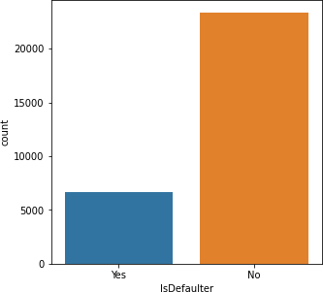
4. Exploratory Data Analysis (EDA)
Both the classes are not in proportion.
Which means that dataset imbalanced.
Data balancing is required.
7

Slide 8
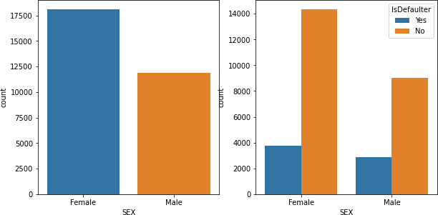
EDA (Continued)
Female credit card holders are larger than male credit cards holders.
As the number female credit card holder is larger than male, their credit card defaults are also higher than male.
8

Slide 9
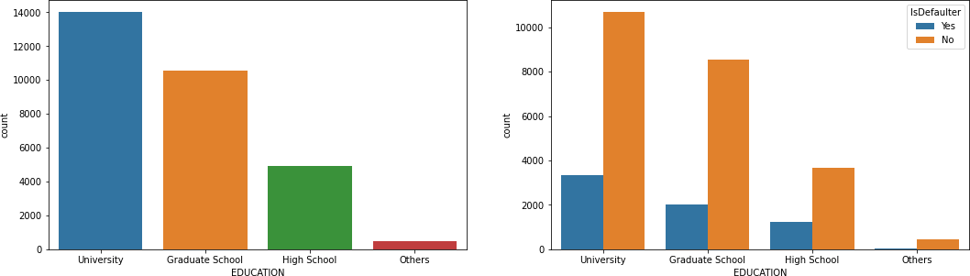
EDA (Continued)
University and graduate school has maximum credit card holder.
As the number university and graduate school credit card holder is higher their credit card default are also higher.

Slide 10
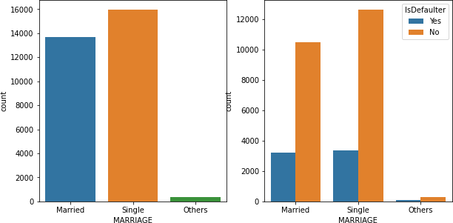
EDA (Continued)
Number of credit card holder is maximum in singles.
But credit card defaults are almost same in case of single and married people.

Slide 11
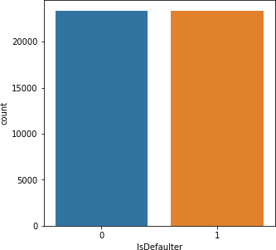
5. Handling Class Imbalance
Both the classes are not in proportion.
SMOTE (Synthetic Minority Oversampling Technique) is the technique to make data class balanced.
SMOTE works by selecting examples that are close in the feature space, drawing a line between the examples in the feature space and drawing a new sample at a point along that line.
After applying SMOTE.
Data class is balanced now.

Slide 12

6. Transformation of Data
To scale data into a uniform format that would allow us to utilize the data in a better way.
For performing fitting and applying different algorithms to it.
The basic goal was to enforce a level of consistency or uniformity to dataset.

Slide 13
7. Splitting Data
Data splits into training dataset and testing dataset.
Training dataset is for making algorithm learn and train model.
Test dataset is for testing the performance of train model.
Here 80% of data taken as training dataset & remaining 20% of dataset used for testing purpose.

Slide 14
8. Fitting Different Model
Following classifier used for prediction credit card default:
• Logistic Regression
• Decision Tree Classifier
• Random Forest Classifier
• Support Vector Machine
• Gradient Boosting
• XG Boosting

Slide 15
9. Cross Validation & Hyperparameter Tunning
It is a resampling procedure used to evaluate machine learning models on a limited data sample.
Basically, Cross Validation is a technique using which Model is evaluated on the dataset on which it is not trained that is it can be a test data or can be another set as per availability or feasibility.
Tuning the hyperparameters of respective algorithms is necessary for
getting better accuracy and to avoid overfitting.

Slide 16
8.1 Logistic Regression
Logistic regression is a machine learning algorithm for classification problem.
In this algorithm, the probabilities describing the possible outcomes of a single trial are modelled using a logistic function.
It is most useful for understanding the influence of several independent variables on a single outcome variable.
LOGISTIC REGRESSION
 | Accuracy |  | Precision | Recall | F1 | AUC
 | Train | Test
Baseline Model | 0.828 | 0.831 | 0.795 | 0.857 | 0.825 | 0.833
Tunned Model | 0.827 | 0.832 | 0.799 | 0.855 | 0.826 | 0.833

Slide 17
8.2 Decision Tree Classifier
Given a data of attributes together with its classes, a decision tree produces a
sequence of rules that can be used to classify the data.
Decision Tree is simple to understand and visualize, requires little data preparation, and can handle both numerical and categorical data.
Decision Tree Classifier
 | Accuracy |  | Precision | Recall | F1 | AUC
 | Train | Test
Baseline Model | 1 | 0.791 | 0.810 | 0.781 | 0.795 | 0.792
Tunned Model | 0.837 | 0.824 | 0.779 | 0.857 | 0.816 | 0.827

Slide 18
8.3 Random Forest Classifier
Random forest classifier is a meta-estimator that fits a number of decision trees on various sub-samples of datasets and uses average to improve the predictive accuracy of the model and controls over-fitting.
The sub-sample size is always the same as the original input sample size but the samples are drawn with replacement.
Random Forest Classifier
 | Accuracy |  | Precision | Recall | F1 | AUC
 | Train | Test
Baseline Model | 1 | 0.863 | 0.821 | 0.897 | 0.857 | 0.866
Tunned Model | 0.844 | 0.833 | 0.794 | 0.860 | 0.826 | 0.835

Slide 19
8.4 Support Vector Machine
Support vector machine is a representation of the training data as points in space separated into categories by a clear gap that is as wide as possible.
New examples are then mapped into that same space and predicted to belong to a category based on which side of the gap they fall.
Support Vector Machine
 | Accuracy |  | Precision | Recall | F1 | AUC
 | Train | Test
Baseline Model | 0.848 | 0.840 | 0.765 | 0.900 | 0.827 | 0.848
Tunned Model | 0.846 | 0.841 | 0.768 | 0.900 | 0.829 | 0.849

Slide 20
8.5 Gradient Boosting
It is a technique of producing an additive predictive model by combining various weak predictors, typically Decision Trees.
Due to this sequential connection, boosting algorithms are usually slow to learn, but also highly accurate.
The final model aggregates the result of each step and thus a strong learner is achieved.
Gradient Boosting
 | Accuracy |  | Precision | Recall | F1 | AUC
 | Train | Test
Baseline Model | 0.847 | 0.843 | 0.801 | 0.875 | 0.836 | 0.846
Tunned Model | 0.951 | 0.866 | 0.824 | 0.899 | 0.860 | 0.868

Slide 21
8.6 XG Boosting
XG Boost is a decision-tree-based ensemble Machine Learning algorithm that uses a gradient boosting framework.
It is a perfect combination of software and hardware optimization techniques to yield superior results using less computing resources in the shortest amount of time.
XG Boosting
 | Accuracy |  | Precision | Recall | F1 | AUC
 | Train | Test
Baseline Model | 0.847 | 0.843 | 0.799 | 0.877 | 0.836 | 0.846
Tunned Model | 0.995 | 0.871 | 0.831 | 0.904 | 0.866 | 0.874

Slide 22
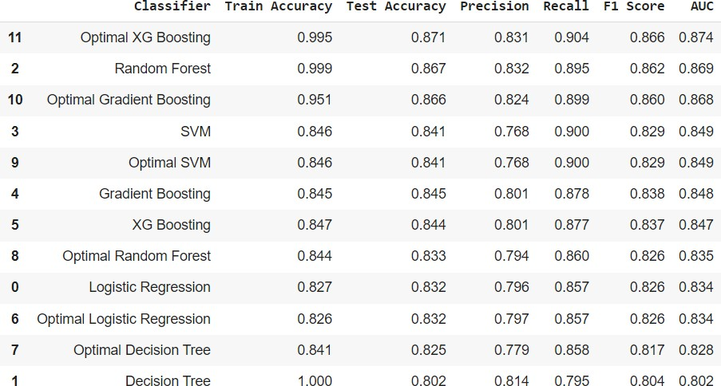
10. Comparison of Model
XG Boost shows highest test accuracy score of 87% and AUC is 0.874.

Slide 23
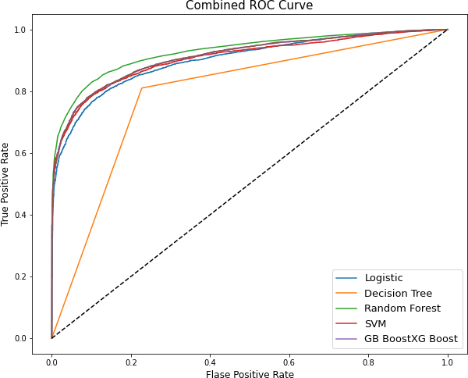
11. Combined ROC Curve
An ROC curve (receiver operating characteristic curve) is a graph showing the performance of a classification model at all classification thresholds.
An ROC curve plots TPR vs. FPR at different classification thresholds.
Lowering the classification threshold
classifies more items as positive, thus increasing both False Positives and True Positives.
23

Slide 24
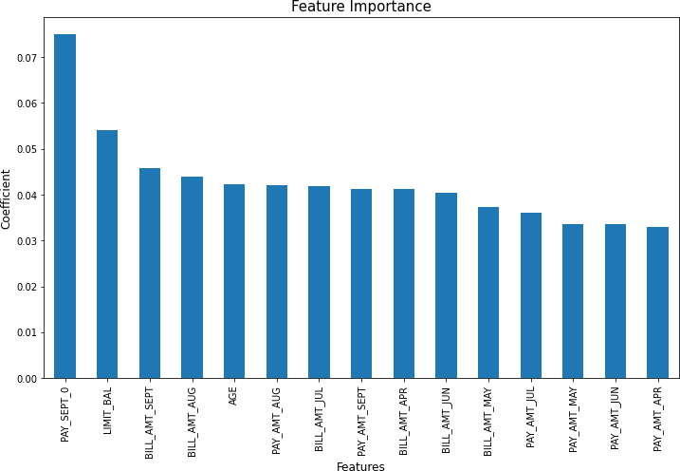
12. Feature Importance
Feature selection is the process of reducing the number of input variables when developing a predictive model.
It is desirable to reduce the number of input variables to both reduce the computational cost of modeling and, in some cases, to improve the performance of the model.
24

Slide 25
13. Conclusion
From all baseline model, Random Forest classifier shows highest test accuracy
and F1 score and AUC.
Baseline model of Random Forest and decision tree shows huge difference in train and test accuracy which shows overfitting.
After cross validation and hyperparameter tunning, XG Boost shows highest test accuracy score of 87% and AUC is 0.874.
Cross validation and hyperparameter tunning certainly reduces chances of overfitting and also increases performance of model.
25

